Slide 1
Report to Showcase My Abilities: Creating Clusters to Guide Business Strategies
Valentin DE BALTHASAR

Slide 2
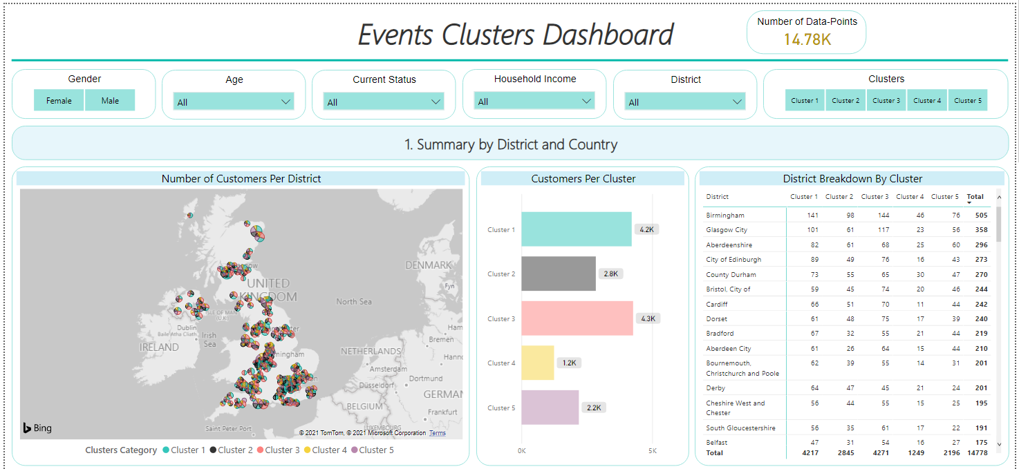
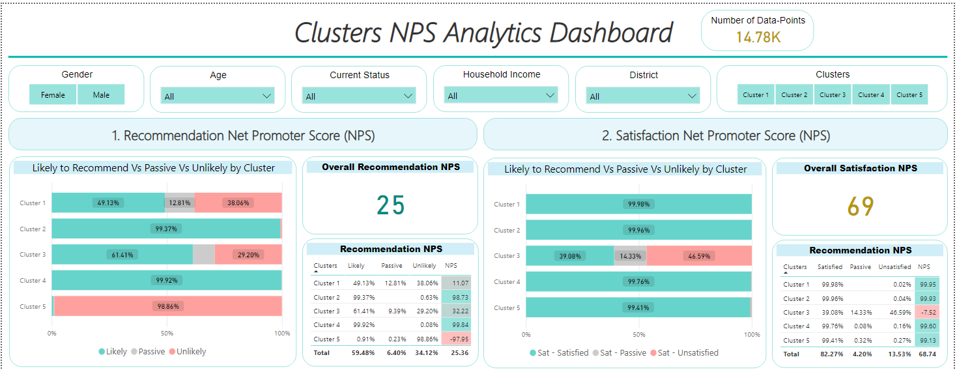

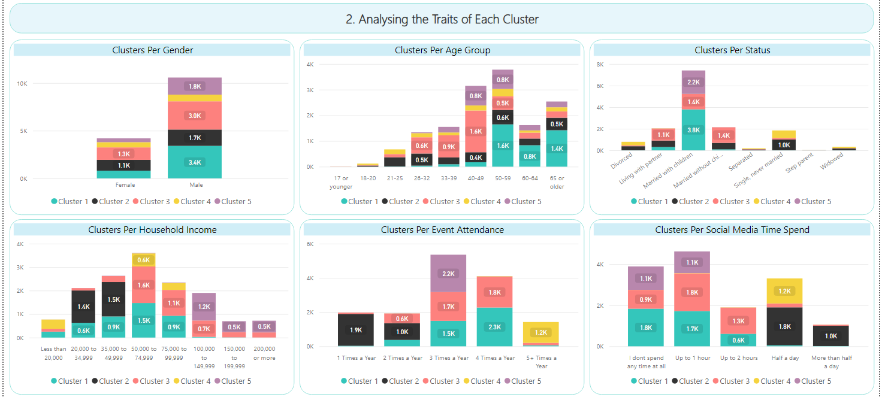
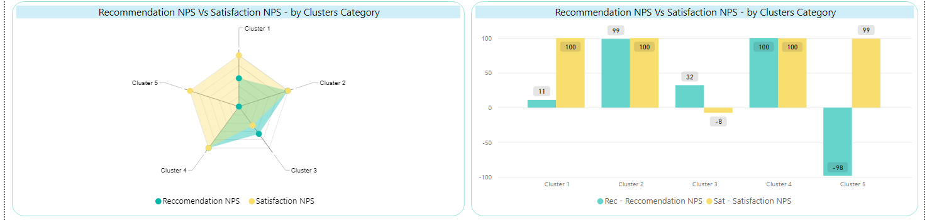

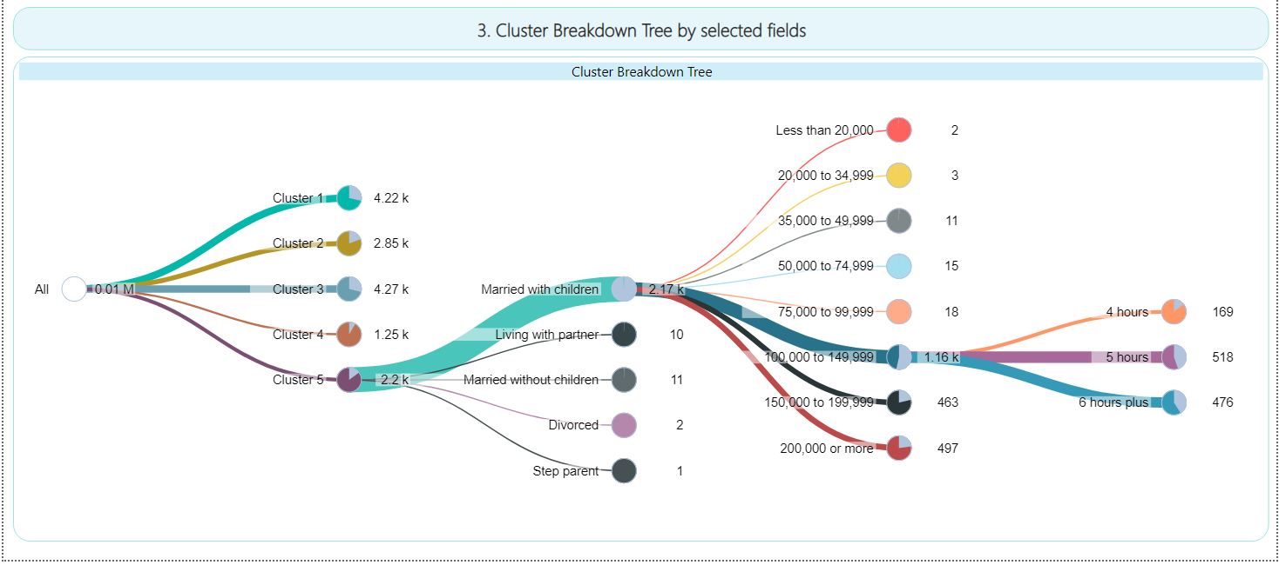
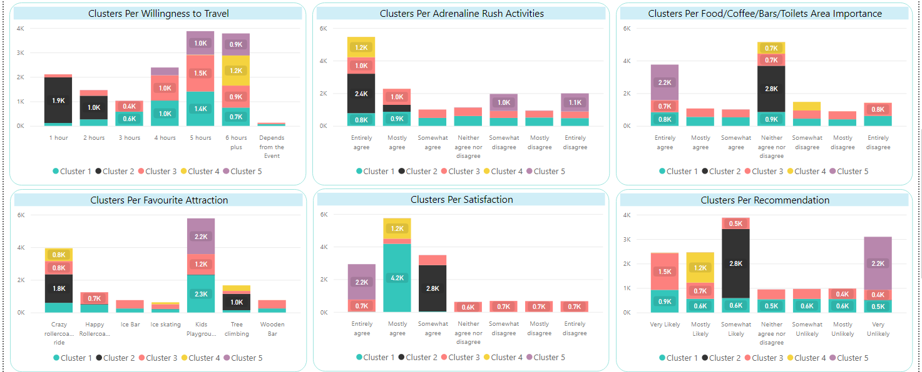

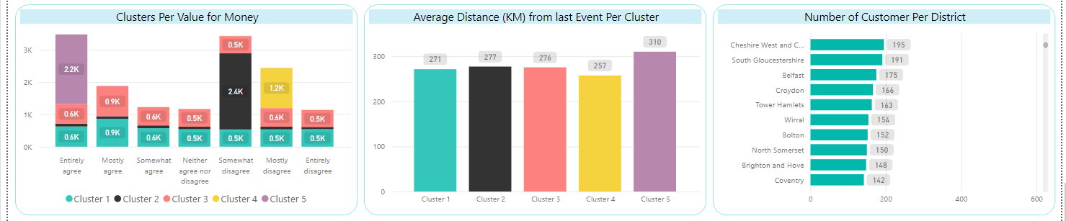
1. Create Interactive Dashboards
Valentin DE BALTHASAR
Raw Excel files
Create a
SQL data frame
Create clusters
Save results into a new SQL data frame
Create dashboards + actionable insights

Slide 3
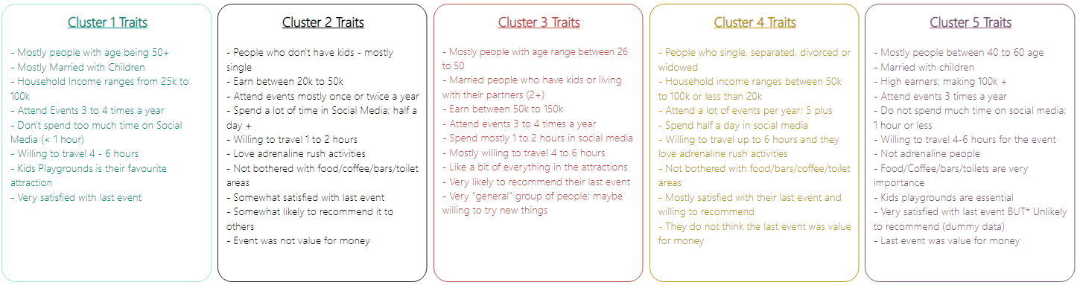
2. Generate Insights to Add Value to the Business
Valentin DE BALTHASAR
Creating clusters’ traits to guide business strategies and save budget
Example: Potential customers in cluster 1 and cluster 5 are mostly going to events that has “kid playgrounds”.
IF the coming event does not have kids playgrounds, THEN do not target customers in cluster 1 and 5 during the marketing campaign.

